Slide 1
AGILE introduction and Scrum Roles

Slide 2
What is Agile?
AGILE is not in itself a method or a process
AGILE is an umbrella term for a set of principles and practices
Under this umbrella, you can find many agile “methods”. Some of these methods are given below. You can find more information on these methods in AGILE COE website
SCRUM is a common framework in AGILE. AT&T adopted SCRUM as its Agile methodology
In this Agile – Scrum framework - bigger products are broken into smaller shippable products in one or more deliveries in time boxed manner
XP – Extreme Programming – commonly used; it is blend of Scrum and Lean. XP focuses on Engg practices.
Scrum – is one of the most commonly used processes. It is not sufficient by itself but when used with Lean and XP makes a solid set of values and practices for delivering software.
Dynamic Systems Development Method (DSDM) – Not common is US, but big in UK.
Lean Development – From Lean Manufacturing and Toyota Production System for software development.
Unified Process (UP) – Developed primarily for Military/Defense.
Feature Driven development (FDD)
Crystal Clear – Alistair Cockburn’s treatment.
Kanban – Less structured then Scrum, apply with processes you are already using. Organize your work on a Kanban board.
2
Notes:
2

Slide 3
Why AT&T is adopting Agile?
From IT delivery point of view, Scrum and other Agile methods will help AT&T identify and deliver products, rapidly. AT&T's Strategic direction is based on competition and consumer demands, Agile techniques help in prioritizing initiatives supporting them. Agile techniques will ensure those products with high business value, be delivered rapidly, helping AT&T to compete in the highly competitive and time-critical world-wide marketplace.
3

Slide 4
What are Scrum Roles?
To carry out the IT implementation using Scrum methodology different roles were defined. Each role has different responsibilities. When all the roles carry out their individual responsibilities, collectively, this allows software work to be prioritized, assessed, managed, developed and delivered iteratively in rapid but fixed intervals
These roles are:
SCRUM Master
Product Owner/Delegate
Project Manager
Delivery Team
4
Notes:
4

Slide 5
Scrum Master Roles and Responsibilities
A good Scrum Master is:
Agile Knowledgeable, a Servant Leader, a Good Communicator
Ensures the team is adhering to the Scrum process
Guardian of quality
Ensures impediments to the team are removed quickly
Improving the lives of the development team by facilitating creativity and empowerment
Facilitates the team to improve their productivity in any way possible
Motivates the team to improve the practices and tools so each increment of functionality is potentially shippable
Radiator of information for the team (metrics, charts, etc.)
Facilitator - sets up and conducts Scrum ceremonies
Represents the team to management
Single point of contact for the Product Owner and Project Manager
Assess and ensure that everyone is aware of the project/ release/ sprint goals
Work with other Scrum Masters to ensure that organizational processes are being improved in order to better support teams

Slide 6
Product Owner/Delegate Roles and Responsibilities
A good Product Owner is:
Committed, a Good Communicator, Present
Aggregates input from users, stakeholders and other interested parties
Has the bandwidth to participate in daily development meetings and is available throughout the day
Available to review daily work product to ensure on track
Defines the features of the product
Prioritizes features according to market value
Adjusts features and priority every iteration, as needed
Accepts or rejects work results
Manages customer/ stakeholder expectations
Drives features vs. schedule vs. resources tradeoff decisions
Primary interface between IT and the customer
Forms a single view of the prioritized requirements
Respects Delivery Team estimates

Slide 7
Agile Project Manager Roles and Responsibilities
A good Agile Project Manager is:
Detailed, Agile and IT UP Knowledgeable, a Good Communicator
Ensure adherence to required process (IT UP, OAA) regardless of methodology being practiced, Waterfall or Agile
Manage estimates and budget in Financial Module in PRISM
Manage timeline and tracking through PRISM
Work with Product Owner Delegate if exists to grow relationship with Product Owner/Client
Foster relationship with Business Consultant, SI Program Manager, Account Managers, Product Owner/Delegate and Scrum Master(s)
Help provide, gather, and communicate delivery status and expectations back and forth from Delivery Team to the Product Owner/Client
Help facilitate any Agile ceremonies that bridge across Scrum teams
Maintain PMT codes and any necessary splits for Agile scope
Ensure identification and management of dependencies and coordination of timelines across interfacing Scrum teams, as well as application teams for blended projects
Help team receive any required tailoring or waivers
Maintain the view of overall delivery status of product
Help track customer satisfaction through surveys and metrics

Slide 8
Delivery Team Roles and Responsibilities
A good Delivery Team is:
Proactive, Adaptive, Diverse, Communicative, and Collaborative
Cross-functional Delivery Team (Dev., QA, etc.)
Composed of everyone required to complete a feature
Ideal size is (5-9)
Members should be full-time
Self-organizing
Estimates and plans work
Designs, codes, tests, and deploys product
Commits to iteration, and delivers

Slide 9
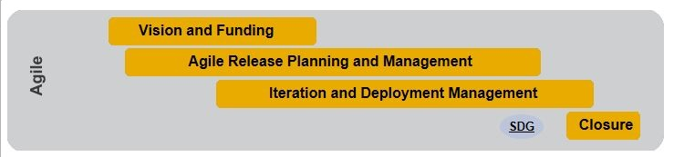
Agile Process Overview
Conti…

Slide 10
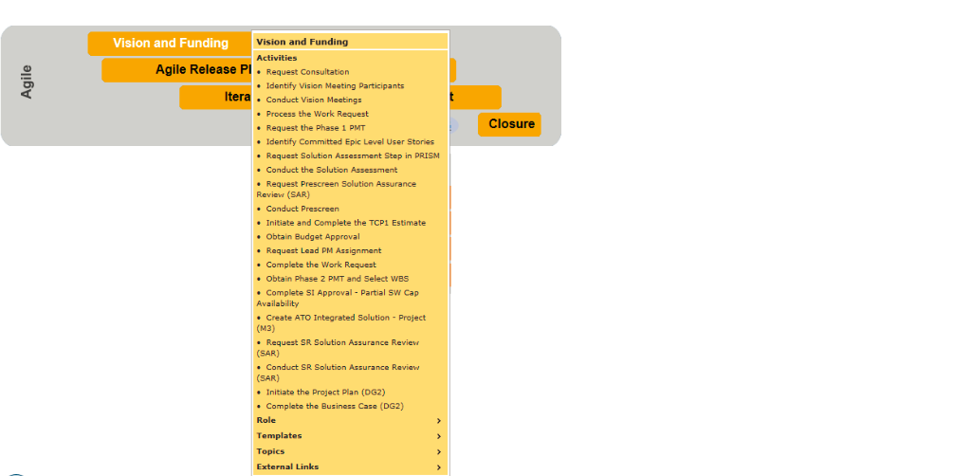
Vision and Funding

Slide 11
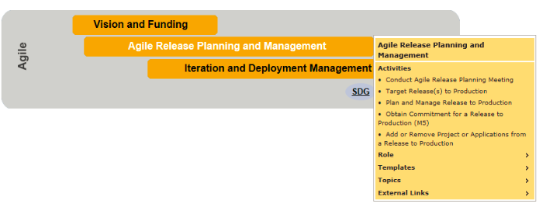
Agile Release Planning and Management

Slide 12
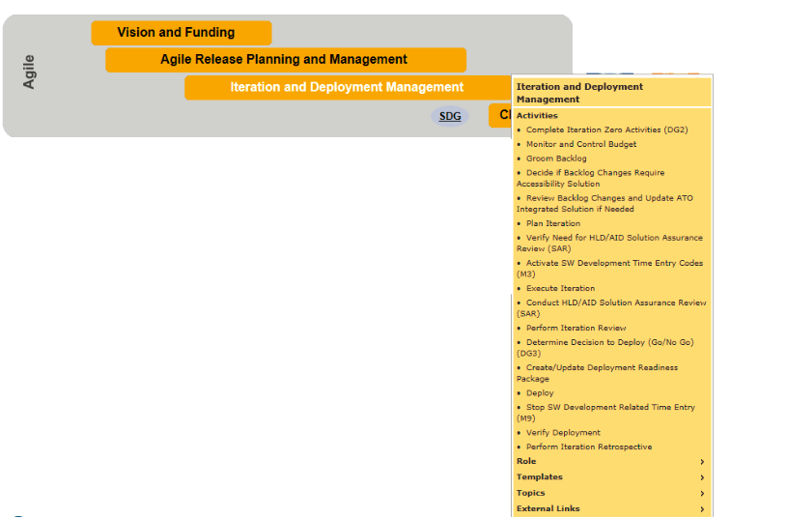
Iteration and Deployment Management

Slide 13
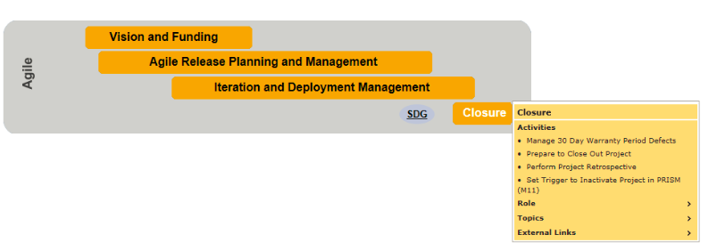
Closure

Slide 14
Agile Scrum R&R
XLS object – Getting error while adding object

Slide 15
ITUP Agile Types
1.ITUP – Agile –
When all the application impacted ( code /TU ) are following agile process
Select ITUP –Agile in Vidur.
2. ITUP – Agile Blended
When some of the impacted applications (code/TU) are following agile and remaining are following ITUP-waterfall
Select ITUP – Agile blended and marked the applications following agile in application tab .

Slide 16
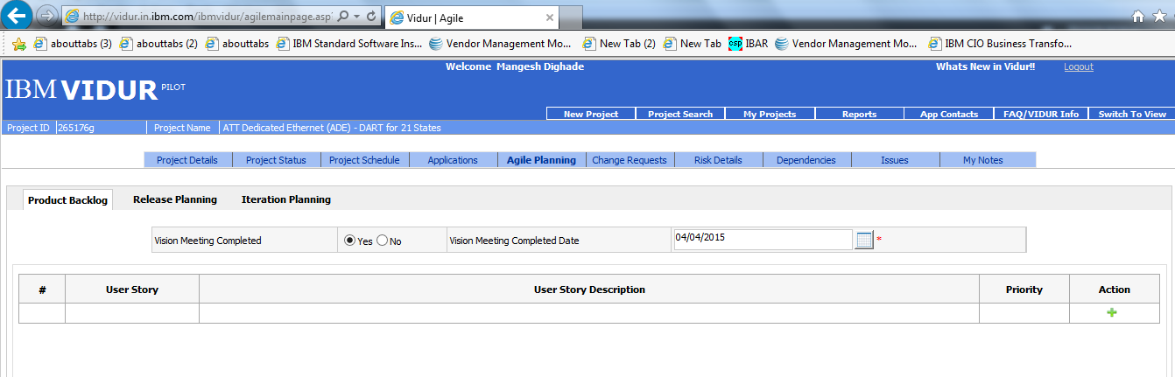
Vidur Agile Planning Tab

Slide 17
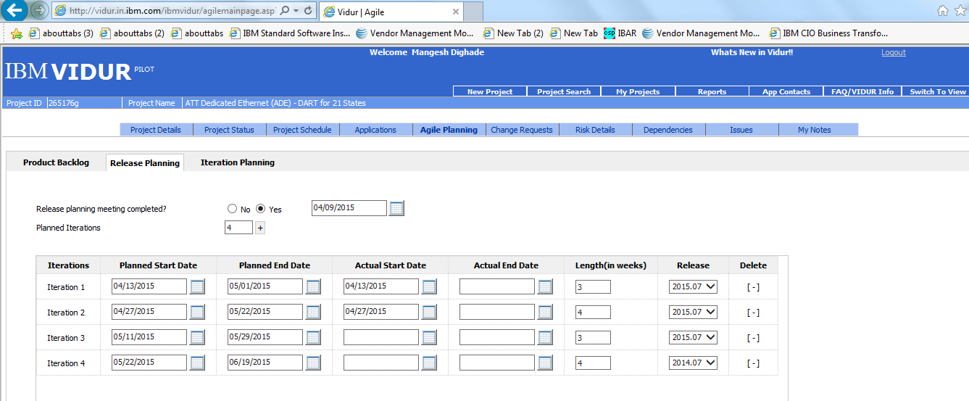
Agile – Release Planning Tab

Slide 18
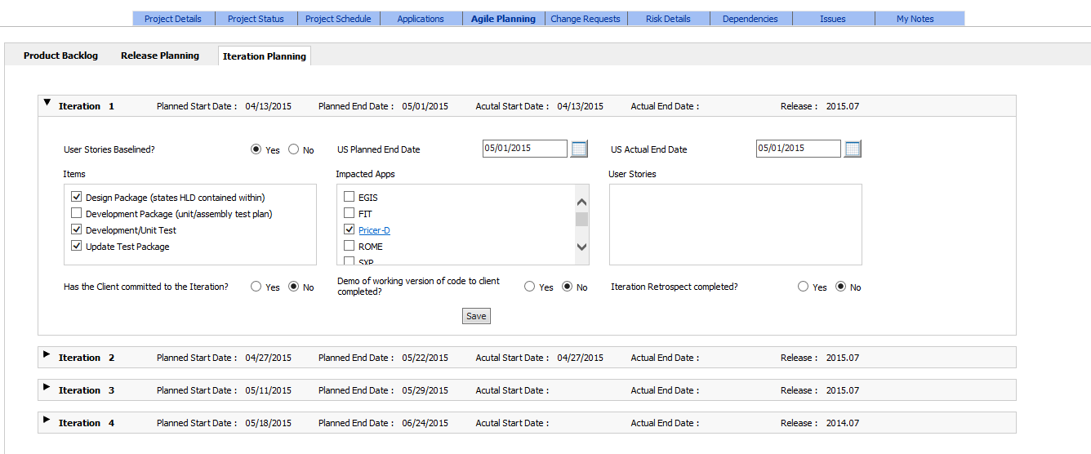
Agile – Iteration Planning tab

Slide 19
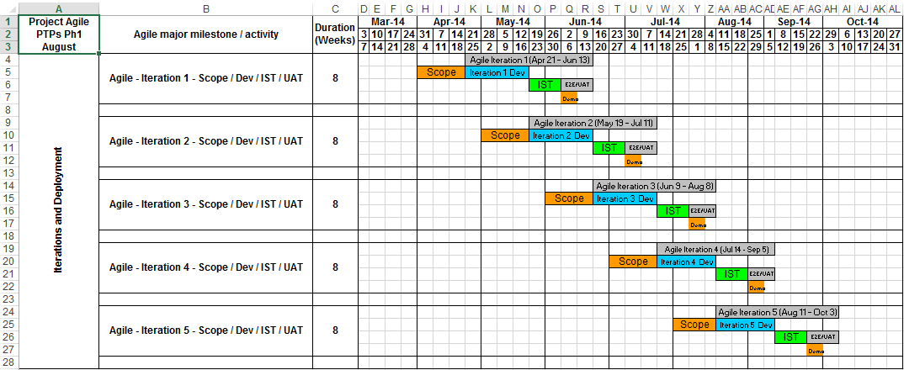
Agile Schedule

Slide 20
Rally Access
1. Getting Access to Rally
Open the following URL to request your access to the RallyDev Tool: http://ushportal.it.att.com/step2.cfm?app=2411&home=ush. In the dropdown selection
1. If you are using RallyDev for first time, select “Request – New User Account”.
( Usually it takes 24 Hrs to resolve the ticket / get access to rally )
2.Getting Access to Project
Once you get Rally access, follow the steps below for project access
1.Navigate to http://ushportal.it.att.com/step2.cfm?app=2411&home=ush
2.Select the dropdown “REQUEST – PROJECT ACCESS”
3.Fill out the entire request form
a.Project(s) to Access (Provide Project Name or Project ID): Need Editor Access to “Project Name” folder as well as all of the child folders.
b.Group (CDE, Interwise, Others): Other
1.Create Ticket

Slide 21
Rally Explained
Rally Screen Shots.
Running through Rally Real time .
It will aslo cover Defect Management in rally

Slide 22
Waterfall to Agile Mapping
Need Gantt chart /inputs from Aji.

Slide 23
Converting a project to Agile
Need inputs what exactly should be included

Slide 24
Live project Example

Slide 25
Links
https://www.rallydev.com/
http://itup.it.att.com/home/index.cfm
http://intranet.att.com/prismolh/it_up_topic_olh/index.htm

